Slide 1
Group 3 Project - Insights into Leptospirosis Research
Helen
Rio
Sneha
Tingxuan
Yuri
Notes:
Insights into Leptospirosis Research:
Good [morning/afternoon], everyone. Thank you for inviting us to share the findings from our analysis of leptospirosis research. We will guide you through the insights we uncovered, and how these can inform your new focus area in therapeutics. Let’s dive right in.

Slide 2
Our Goal :
Identify key active researchers.
Determine collaboration networks of researchers.
Determine research trend.
Notes:
We analyzed three datasets provided by you: one containing article/publication details, another listing full author information and a list containing the number of publications. From this, we extracted insights into who the researchers are, how they’re collaborating, and how the field has evolved over time.

Slide 3
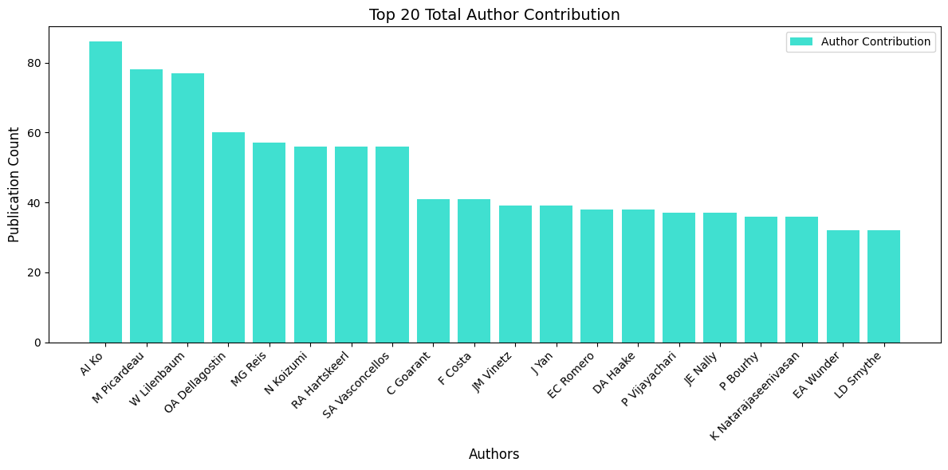
Most active researchers
Top Overall Contributing Authors
Authors that are involved with the most publications
Notes:
This chart highlights the top researchers based on the overall number of publications. Researchers like AI Ko (highest pub count), followed by M Picardeau, W Lilenbaum consistently contribute to the field. We recommend prioritizing engagement with these individuals to tap into their knowledge and networks.

Slide 4
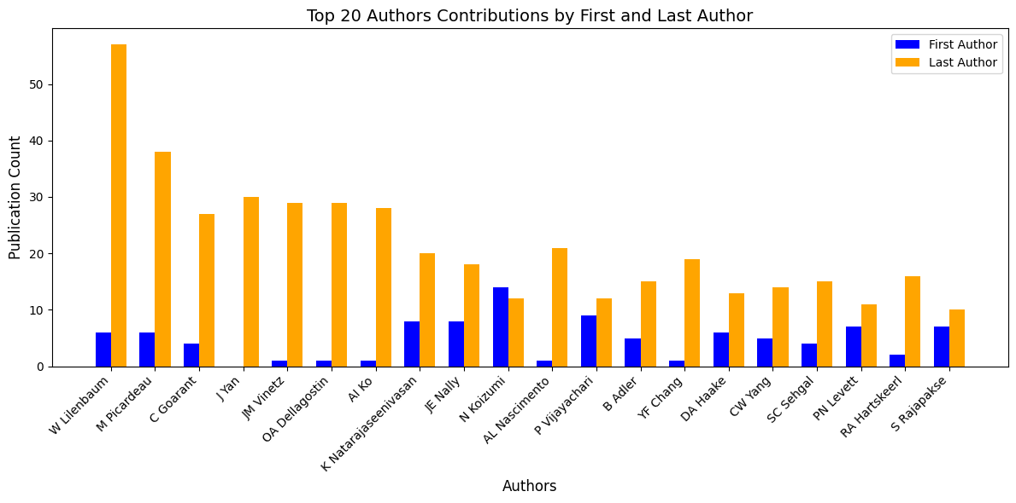
Most active researchers
Top contributing author by first and last author position only:
First author -> Most significant contributor
Last author -> supervisor or principal investigator.
Rio
Notes:
This graph tells us the most contributing authors based on position as a first author and last author. The reason is because the first author positions is reserved for the author that has the most contribution to the publication. While the last author position is reserved for the person/researcher that has the most senior position acting as supervisor or principal investigator. The blue bar represents the number of contribution as first author, while the orange bar represents the number of contribution as last author. W Lilenbaum has the highest number of publications as first and last author, followed by M Picardeau and C Goarant

Slide 5
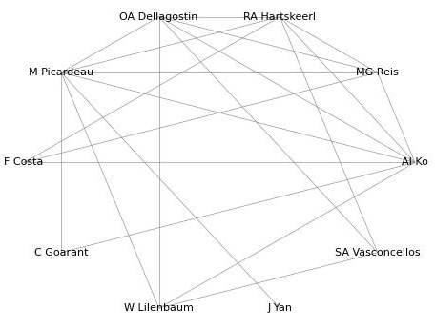
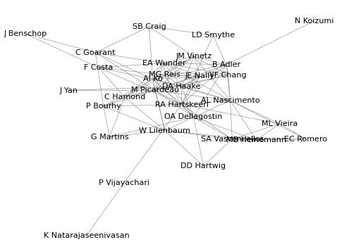
Collaboration between most active researchers
Collaborations between the 10 most active researchers
Collaborations between the 30 most active researchers

Slide 6
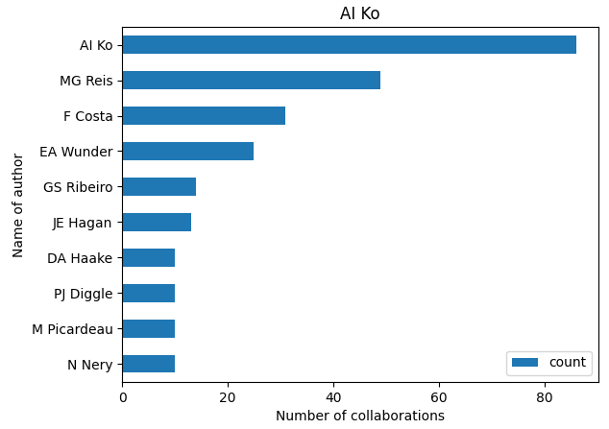
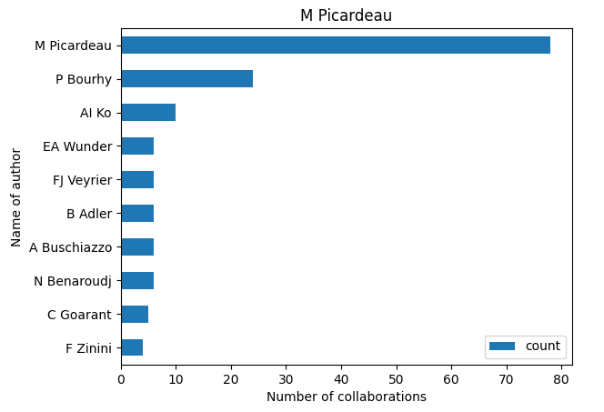
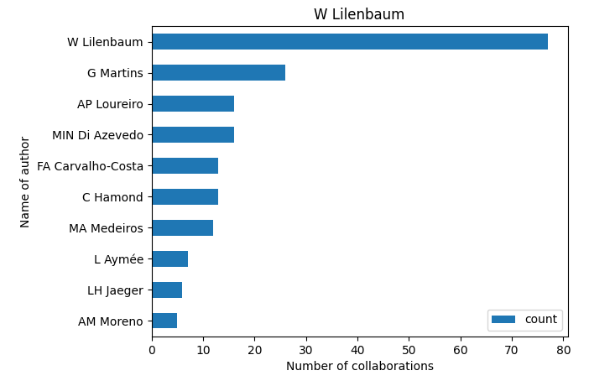
Researchers who top authors collaborated with most

Slide 7
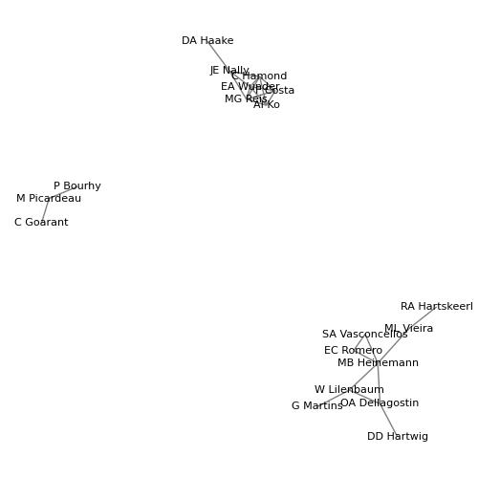
Recent collaborations
Recent (since 2020) collaboration between top 30 researchers

Slide 8
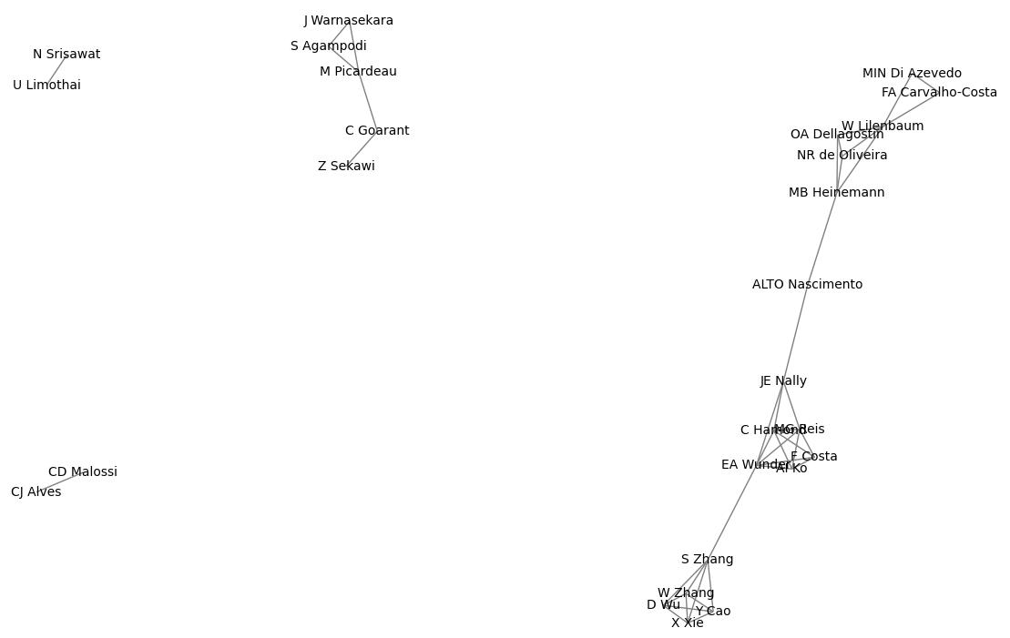
Collaboration between recently active researchers
Recent (since 2020) collaboration between researchers most active since 2020

Slide 9
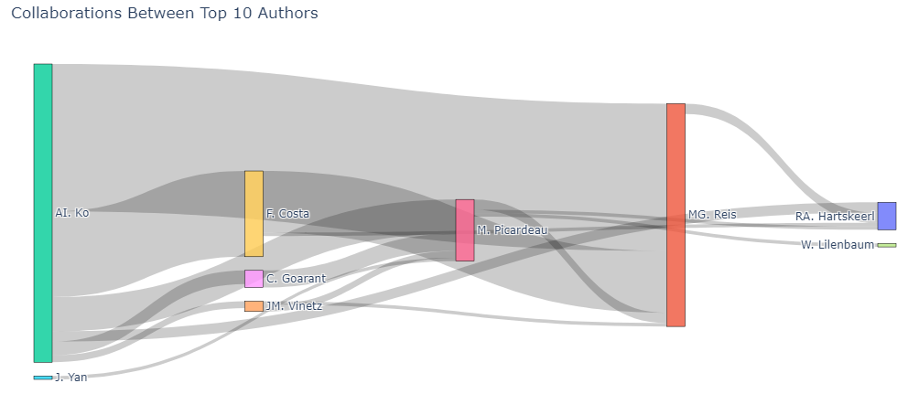
Collaborations between the top 10 authors overall
Significant Collaborators - AI. Ko, MG. Reis, F. Costa, M. Picardeau

Slide 10
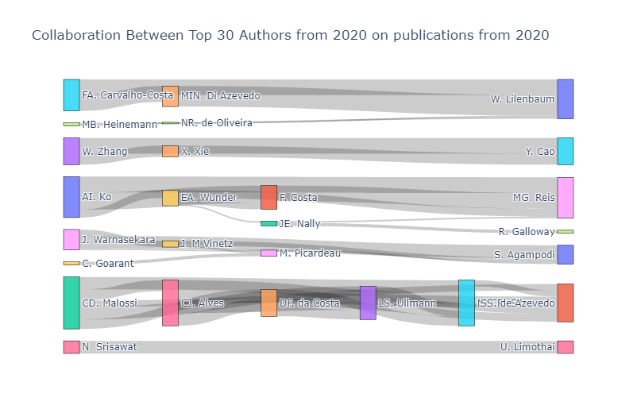
Collaborations between the top 30 authors from 2020
A few distinct collaboration groups with significant recent collaborations observed.
Possible indicator of different ideologies and approaches in the field of Leptospirosis.

Slide 11
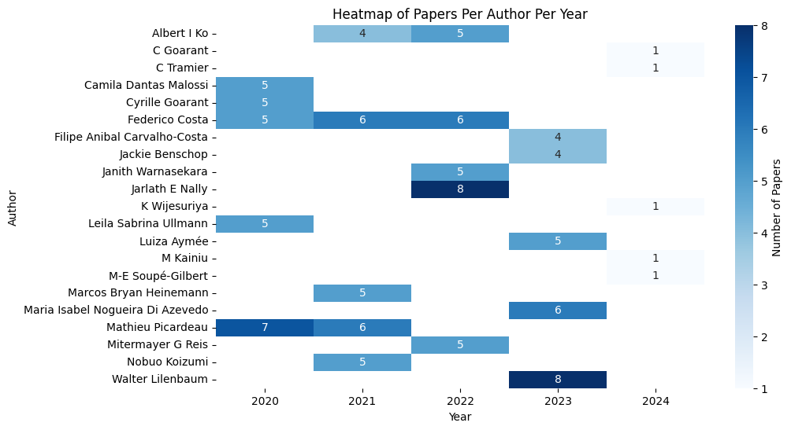
Number of papers published by the top authors per year since 2020
Time period: 2020 - 2024
Some Key Contributors: Frederico Costa, Mathieu Picardeau, Walter Lilenbaum

Slide 12
Topic Distribution Over Time
Classified articles into 6 topics.
Analyzed yearly topic trends using a Stacked Area Chart.
Focused on the top 3 topics and extracted authors with the most articles.
Data Sources:
articles.leptospirosis.csv
PMID, Title, Abstract, Journal, Year, FirstAuthorForename, FirstAuthorLastname, FirstAuthorAffiliation
authors.leptospirosis.csv
PMID, AuthorN, AuthorForename, AuthorLastname, AuthorAffiliation
paper_counts.csv
Year, Count
ML Techniques:
TF-IDF (Term Frequency-Inverse Document Frequency):
For converting text data (title + abstract) into numerical features.
Latent Dirichlet Allocation (LDA):
A topic modeling technique used to discover topics in the text data.
Cosine Similarity:
For measuring the similarity between topics based on their top words.

Slide 13
Leptospirosis Research Topics
Topic 1:
Diagnostic methods and tests for leptospirosis assay, diagnosis, pcr, elisa, test, detection, sensitivity, igm, diagnostic, mat
Topic 2:
Leptospira proteins and pathogenicity leptospira, interrogans, proteins, protein, vaccine, pathogenic, leptospiral, leptospirosis, host, expression
Topic 3:
Severe clinical signs of leptospirosis leptospirosis, patients, severe, acute, clinical, case, fever, renal, pulmonary, failure
Topic 4:
Inflammatory cytokine response in leptospirosis
il, levels, cytokine, cytokines, inflammatory, activation, tnf, response, cell, inflammation
Topic 5:
Leptospirosis in animals and associated risks
leptospira, leptospirosis, dogs, serovars, samples, animals, study, serovar, species, risk
Topic 6:
Human health impact and zoonotic risks of leptospirosis
leptospirosis, health, disease, risk, diseases, factors, human, incidence, public, zoonotic
Notes:
These are topic details
These titles are only for presentation

Slide 14
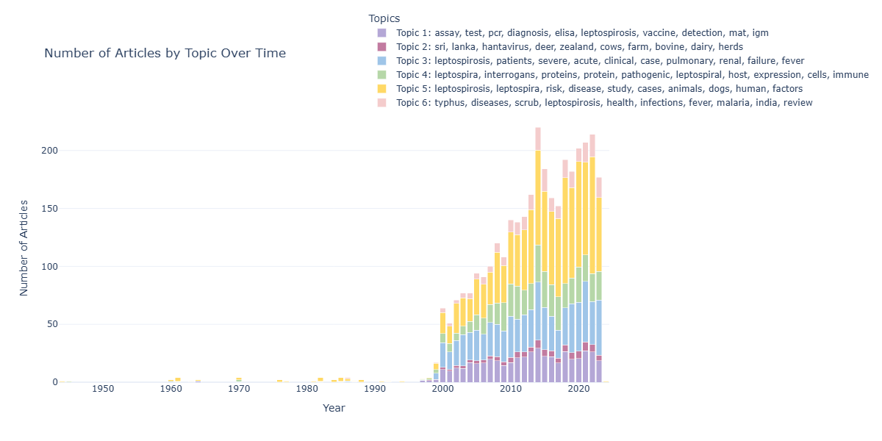
Topic Distribution Over Time
Topic 3: Severe clinical signs of leptospirosis leptospirosis, patients, severe, acute, clinical, case, fever, renal, pulmonary, failure
Topic 5: eptospirosis in animals and associated risks
leptospira, leptospirosis, dogs, serovars, samples, animals, study, serovar, species, risk
Topic 6: Human health impact and zoonotic risks of leptospirosis
leptospirosis, health, disease, risk, diseases, factors, human, incidence, public, zoonotic
Notes:
Topic 5: This topic shows a sharp increase and stays at a high level, especially in the years after 2000. It has been getting a lot of attention.
Topic 3: This topic grew quickly, especially after 2000. It has noticeable changes in recent years.
Topic 6: This topic has stayed at a high level consistently, so it’s also an important one to focus on.
These topics seem to be the most important because they have shown strong growth or consistent high interest over the years

Slide 15
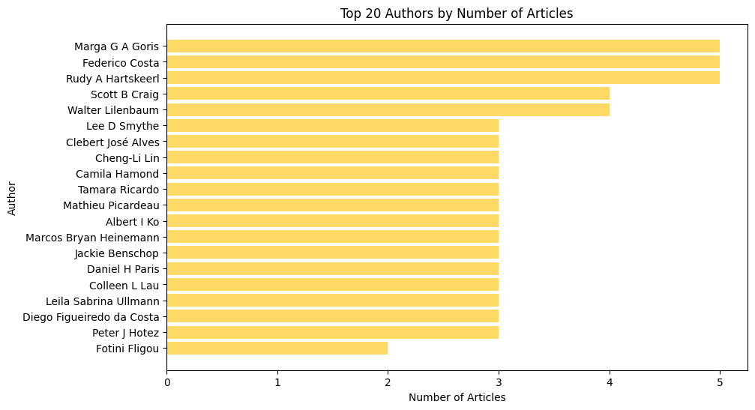
Top 20 Authors Ranked by Total Publications of 3 topics

Slide 16




ML Techniques and Their Roles
Tool/Model | Purpose | License | Commercial Use
Pandas | Data manipulation and analysis | BSD License | Yes
NumPy | Numerical computing | BSD License | Yes
Matplotlib | Data visualization | Matplotlib License | Yes
Scikit-learn | Machine learning library | BSD License | Yes
These licenses comply with industry standards for research and application.

Slide 17
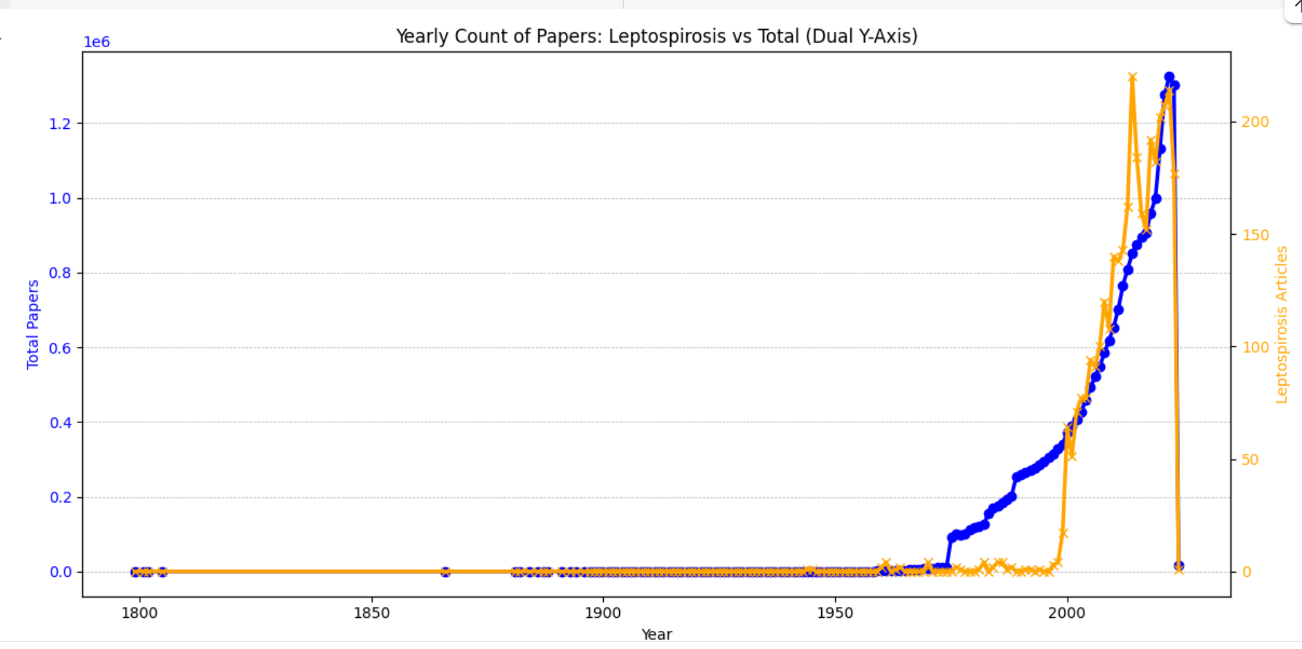
Changes over time
Blue: Total number of articles: Orange: Number of leptospirosis articles

Slide 18
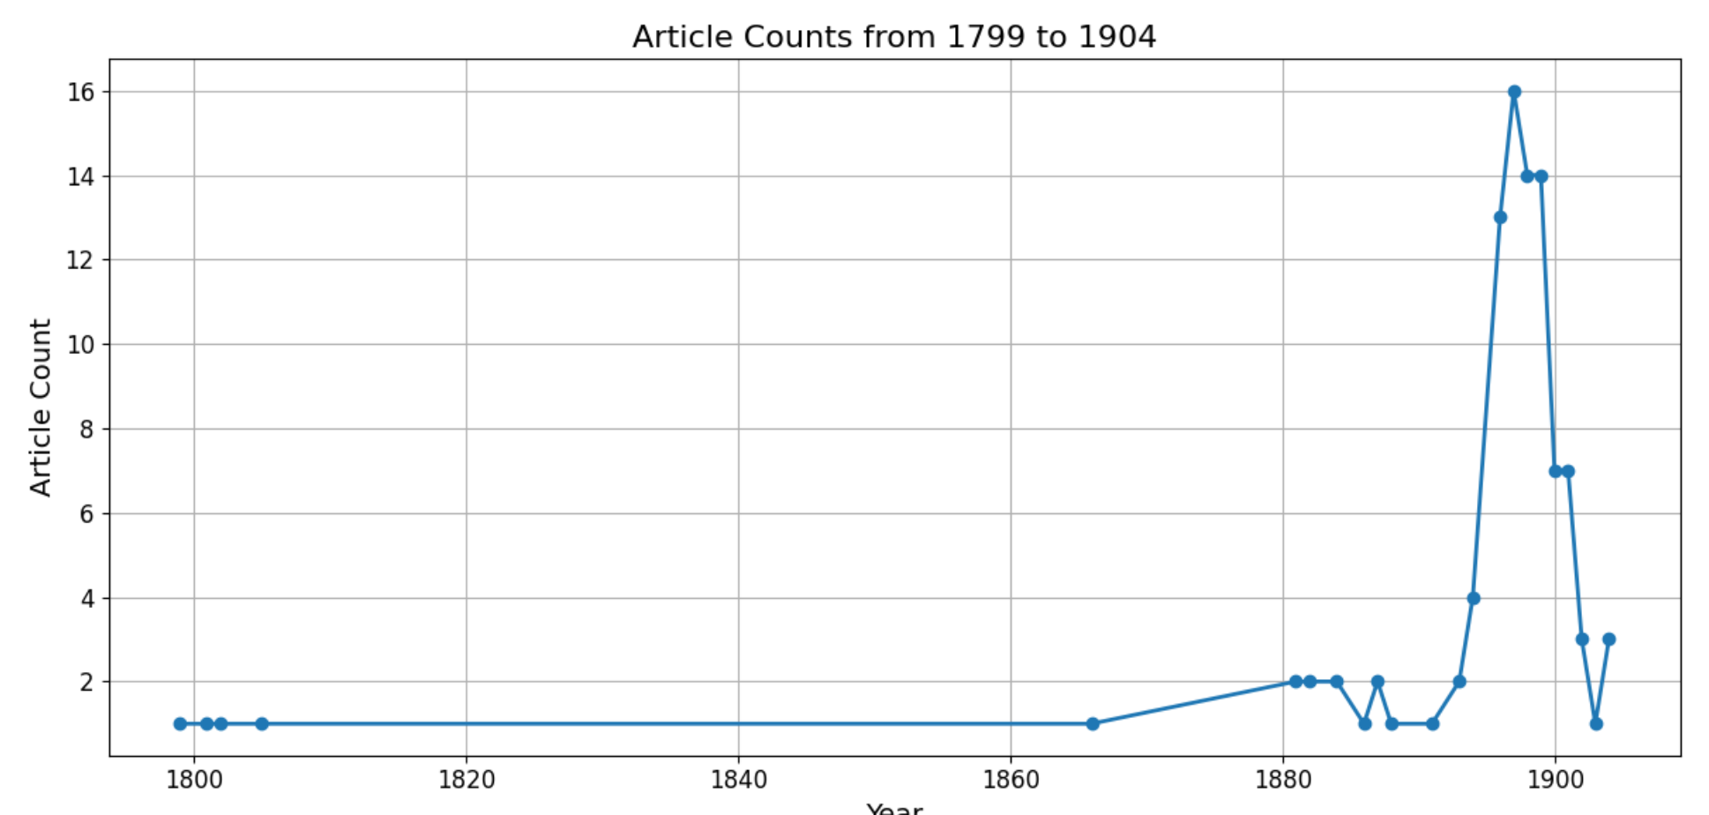
Early stage of development
Year range: 1799 to 1904.
Trends: relatively stable
Leptospirosis: blank

Slide 19
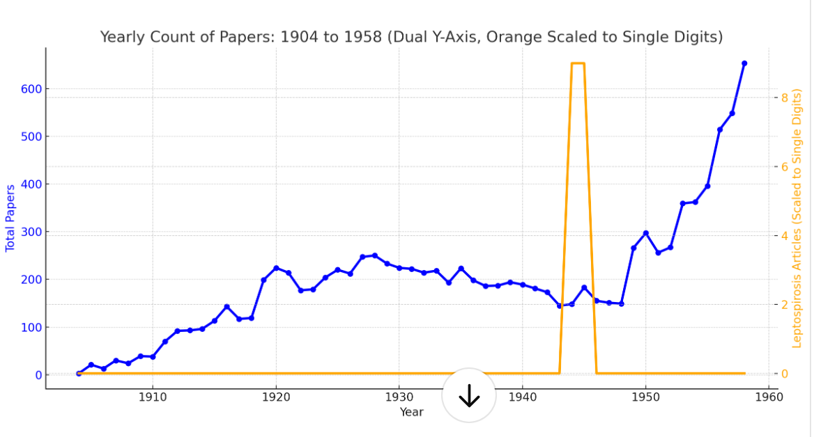
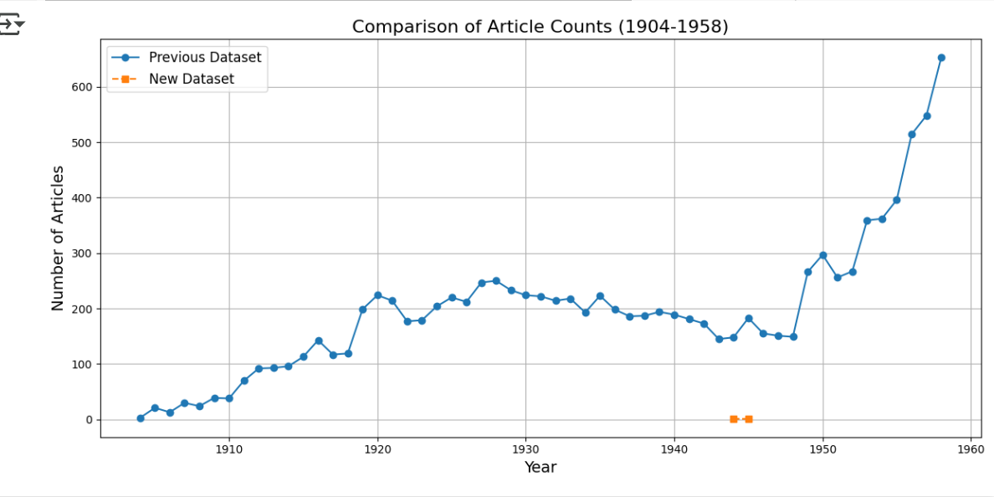
Period of continuous development
Year range: 1904 to 1958.
Increase
but proportions is still low
sporadic exploration to systematic research

Slide 20
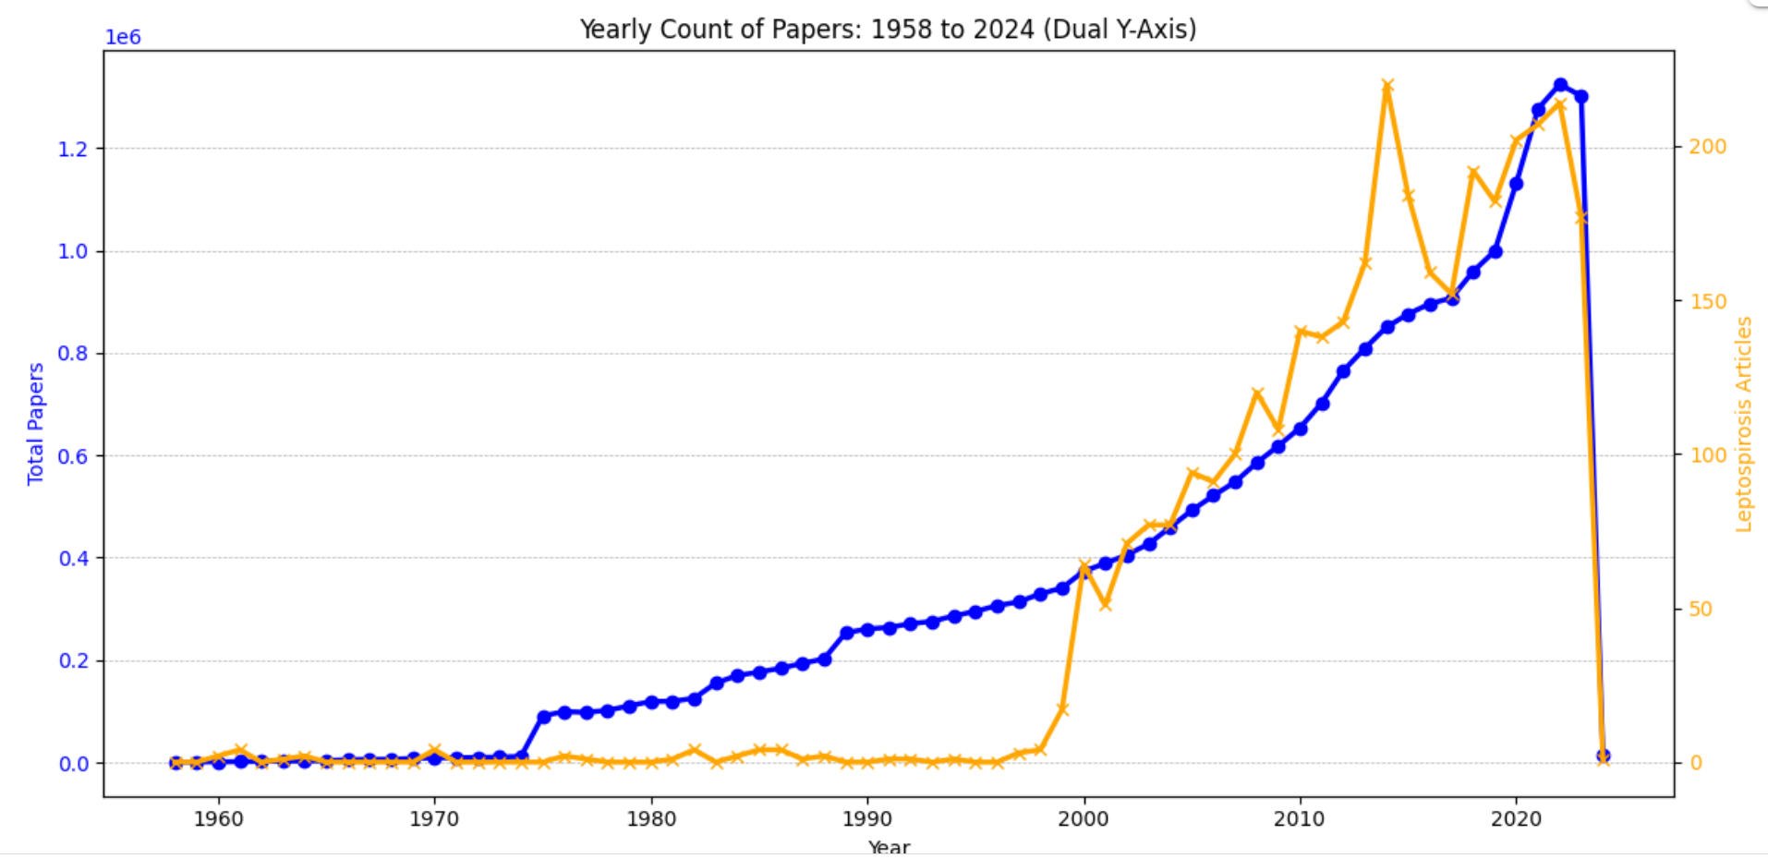
Period of rapid development
Year range: 1958 to 2024.
total number :
showed an exponential growth
leptospirosis articles :
a slow but steady increase

Slide 21
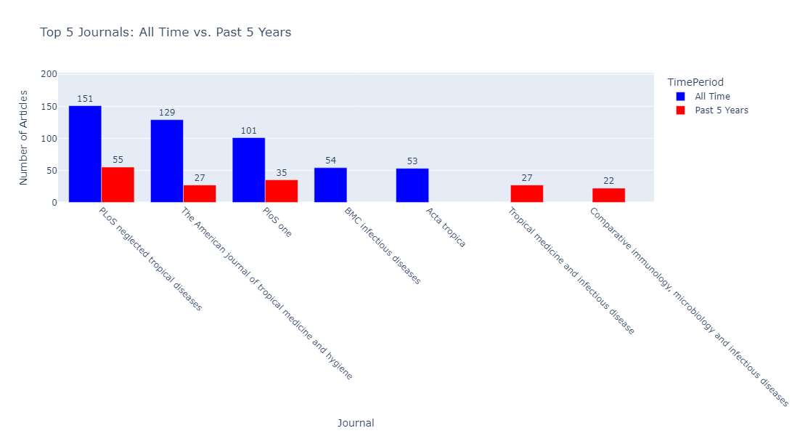
Top 5 journals with leptospirosis articles
PLoS One PLoS Neglected Tropical Diseases and The American Journal of Tropical Medicine and Hygiene have continued relevance over the years.
Tropical medicine and Infectious Disease, and Comparative Immunology, Microbiology and Infectious Diseases are upcoming journals.

Slide 22
Conclusions
Active Researchers
Identified top authors from overall publications: A.I. Ko (highest), followed by M. Picardeau and W. Lilenbaum.
Based on position as first author and last author: W. Lilenbaum (highest), followed by M. Picardeau and C. Goarant.
Collaboration Networks
Large amount of collaboration between top authors over the full time period.
Number of collaborations between authors varied, with large numbers between some (e.g., A.I. Ko and M.G. Reis).
Several distinct collaboration groups were found among the top 30 researchers since 2020.
Leptospirosis Research topics
Trends over time by dividing Leptospirosis Research Topics into 10 categories and examining the number of related publications. The topic "Leptospira and Animals" (e.g., the role of leptospirosis in animals like dogs and studies on serovars) showed consistent research interest, with a significant increase in publications in 2024, highlighting its growing attention among researchers.
Development of General research and Leptospirosis
1958 to 2024 a slow but steady increase of leptospirosis research

Slide 23
Thank You!
Any Questions?

